Slide 1
Inverse proportion in context
Understanding multiplicative relationships: percentages and proportionality

Slide 2
how to use Oak lessons

Slide 3
I can recognise inverse proportion graphically and use inverse proportionality in a range of contexts.

Slide 4
Two variables are inversely proportional if there is a constant multiplicative relationship between one variable and the reciprocal of the other.

Slide 5

Inverse proportion in context
Graphs of inverse proportion
Using inverse proportion to find missing values

Slide 6



Graphs of inverse proportion
It takes 3 people 2 days to paint a fence. How long will it take 6 people?
Do you agree with Sam?
Izzy doesn’t think that Sam is right.
If you double the number of people then you will double the time.
How can the job take longer if more people are doing it?
Sam
Izzy

Slide 7
Graphs of inverse proportion
Let’s take a look a slightly easier problem.
It takes 1 person 6 days to paint this fence.
How long will it take 2 people?
We will start by thinking about how many panels 1 person can paint in a day.
6 panels ÷ 6 days = 1 panel per day

Slide 8
Graphs of inverse proportion
Let’s take a look a slightly easier problem.
It takes 1 person 6 days to paint this fence.
Day 1
Day 1
Day 2
Day 2
Day 3
Day 3
To see the difference between the 2 people we will use different shading.
Person 1 (shaded)
Person 2 (unshaded)
It would take 2 people 3 days to paint the same fence.

Slide 9
Graphs of inverse proportion
Let’s take a look a slightly easier problem.
It takes 1 person 6 days to paint this fence.
Day 1
Day 1
Day 1
Day 2
Day 2
Day 2
How long will it take 3 people to paint the same fence?
Person 1 (dark shading)
Person 2 (unshaded)
Person 3 (light shading)
It would take 3 people 2 days to paint the same fence.

Slide 10
Graphs of inverse proportion
Let’s put the information we have into tables:
people | days
1 | 6
2 | 3
people | days
1 | 6
3 | 2
So, as the number of people increases the number of days decreases.
That does make sense. This must mean that the number of people and days are not directly proportional.
Sam
Izzy

Slide 11
Graphs of inverse proportion
I remember that we could draw graphs of direct proportion. They looked like this.
Graphical representation of direct proportion
Direct proportion means as one variable increases the other increases at the same rate. This relationship in the fence problem shows that as one variable increases the other decreases.
Sam
Maybe the graph will look like this.
What do you think?
Izzy

Slide 12
Graphs of inverse proportion
Sam and Izzy are working on this problem that their teacher has set them.
Find as many rectangles as you can with an area of 24 cm².
24 cm²
w
That’s all of them. Isn’t it?
l
1 cm x 24 cm = 24 cm²
2 cm x 12 cm = 24 cm².
3 cm x 8 cm = 24 cm²
4 cm x 6 cm = 24 cm²
Sam
Do you agree with Sam?
Izzy

Slide 13
Graphs of inverse proportion
Find as many rectangles as you can with an area of 24 cm².
24 cm²
w
l
I see! There are an infinite number of rectangles dependent on the degree of accuracy used to measure the dimensions.
Wait, there are more! For example, 2.4 cm by 10 cm gives an area of 24 cm².
Do you agree with Sam?
Sam
Izzy

Slide 14
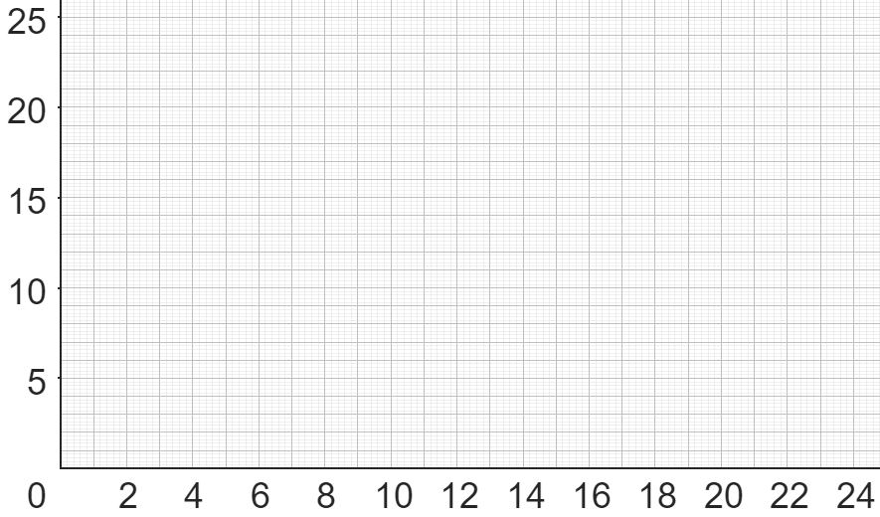
Graphs of inverse proportion
Let’s take a look at a graph representing this problem.
w
x
We will plot some points we know.
Let’s start with:
(1, 24)
We can reverse the coordinates.
x
l

Slide 15
Graphs of inverse proportion
Let’s take a look at a graph representing this problem.
w
x
We will plot some points we know,
and now:
x
(2, 12)
Again, reverse the coordinates.
x
x
l

Slide 16
Graphs of inverse proportion
Let’s take a look at a graph representing this problem.
w
x
We will plot some points we know,
and now:
x
(3, 8)
x
Again, reverse the coordinates.
x
x
x
l

Slide 17
Graphs of inverse proportion
Let’s take a look at a graph representing this problem.
w
x
We will plot some points we know,
and now:
x
(4, 6)
x
Again, reverse the coordinates.
x
x
x
x
x
l

Slide 18
Graphs of inverse proportion
Let’s take a look at a graph representing this problem.
w
x
We will plot some points we know,
and now:
x
(4.8, 5)
x
Again, reverse the coordinates.
x
x
x
x
x
x
x
l

Slide 19
Graphs of inverse proportion
w
x
It looks like this is forming a curve.
x
Do you agree with Sam?
This does form a curve.
x
x
x
x
x
x
x
x
l

Slide 20
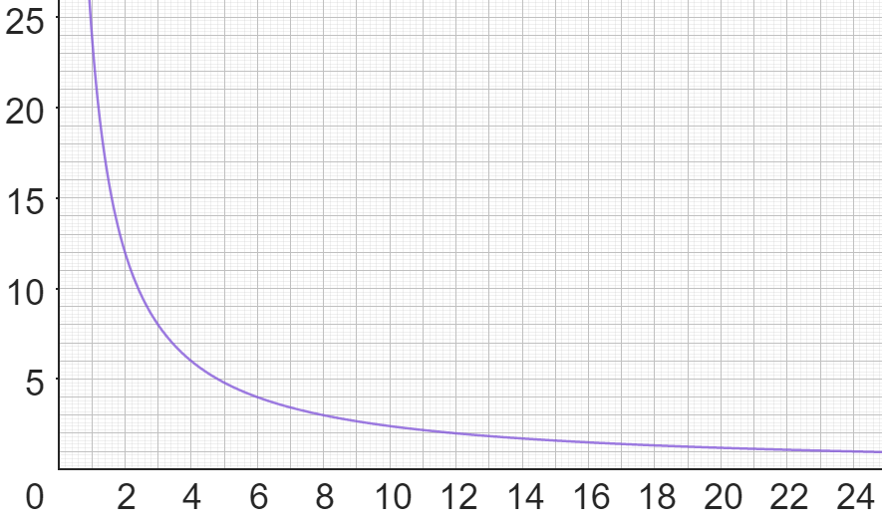
Graphs of inverse proportion
Yes, Sam is right.
Sam’s previous idea was pretty close. However, it forms a curve not a straight line.
w
l

Slide 21
Graphs of inverse proportion
This is an example of inverse proportion.
As one variable increases the other decreases in proportion.
In this example, as the width of the rectangle increases the length decreases to keep the area at 24 cm².
Can you think of any other examples of inverse proportion?
As the speed of the car increases the time taken to cover a certain distance decreases.
The number of people doing something and the time it takes to do it. As the number of people increases, the time it takes to finish decreases.

Slide 22
Graphs of inverse proportion
w
l
We can use this graph to read off possible dimensions of our rectangle.
E.g. If the length is 10 cm
The width is 2.4 cm

Slide 23
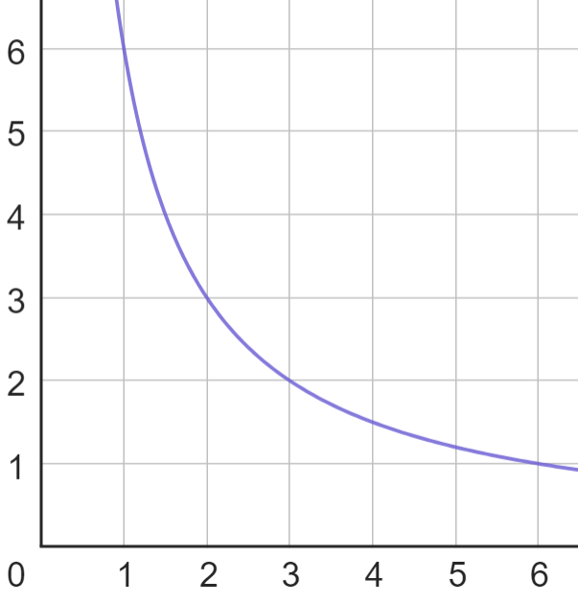
Graphs of inverse proportion
d
It was possible to read values from the graph representing our rectangle.
This is the graph representing the fence problem.
How many people will I need if I want the job finished in 5 days?
Why is this not appropriate?
You can’t have 1 and a bit of a person!
p

Slide 24
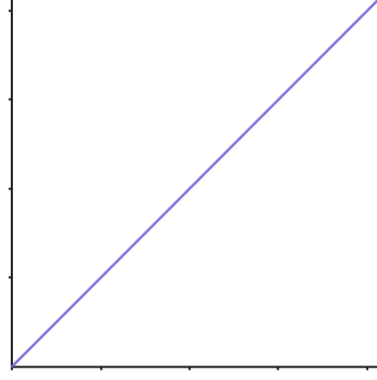
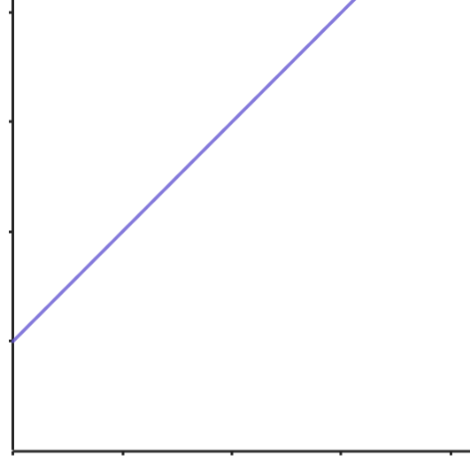
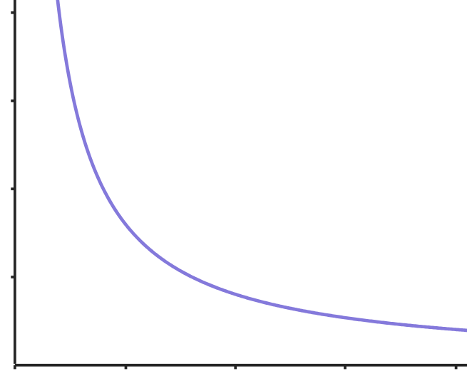
Graphs of inverse proportion
Match each graph to the correct description.
direct proportion
neither
inverse proportion

Slide 25
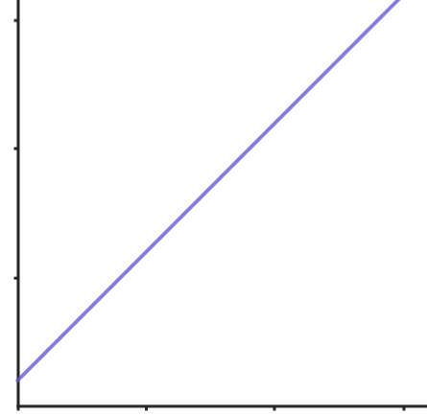
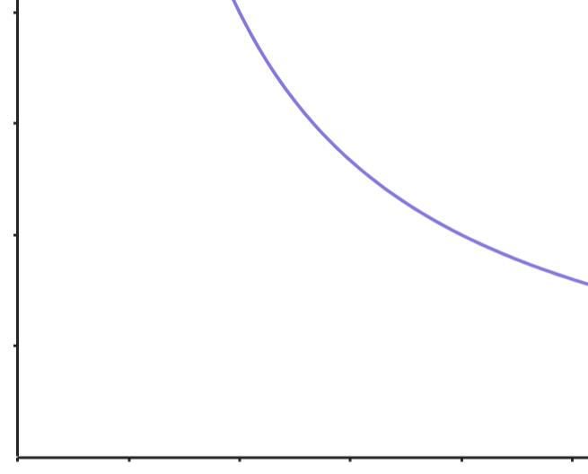
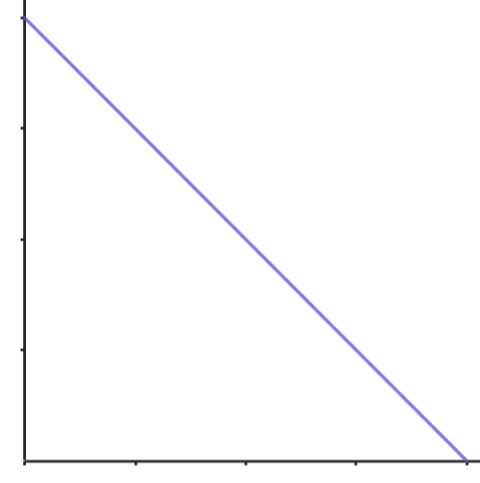
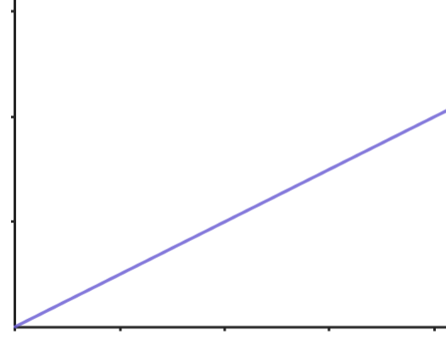
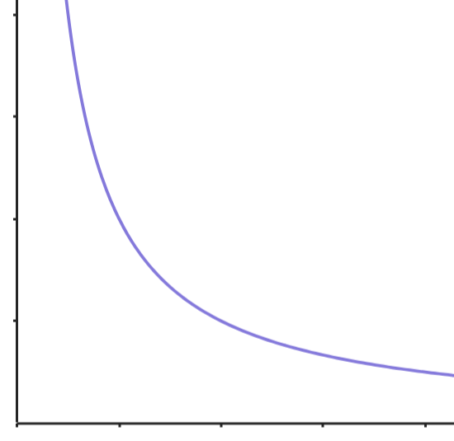
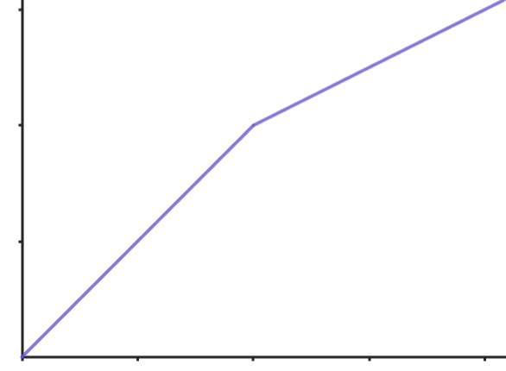
Graphs of inverse proportion
1) Label each of the graphs as direct proportion, inverse proportion or neither.
a)
b)
c)
d)
e)
f)

Slide 26
Graphs of inverse proportion
2) Decide if the following situations are directly or inversely proportional:
a) The number of taps and the time taken to fill a bath.
b) The number of Euros exchanged and the number of pounds.
c) The number of boxes of tiles bought and the cost.
d) The number of days to dig a hole and the number of people.
e) The time taken to get to Edinburgh and the speed of the car.

Slide 27
Graphs of inverse proportion
1) Label each of the graphs as direct proportion, inverse proportion or neither.
a)
b)
c)
neither
inverse proportion
neither
d)
e)
f)
neither
direct proportion
inverse proportion

Slide 28
Graphs of inverse proportion
2) Decide if the following situations are directly or inversely proportional:
a) The number of taps and the time taken to fill a bath. inverse
b) The number of Euros exchanged and the number of pounds. direct
c) The number of boxes of tiles bought and the cost. direct
d) The number of days to dig a hole and the number of people. inverse
e) The time taken to get to Edinburgh and the speed of the car. inverse

Slide 29
Inverse proportion in context
Graphs of inverse proportion
Using inverse proportion to find missing values

Slide 30
Using inverse proportion to find missing values
Yes, we did Sam. I assume we can use them for inverse proportion as well.
When we worked on direct proportion we used ratio tables.
Sam
Izzy
Let’s consider the rectangle example from earlier.

Slide 31
Using inverse proportion to find missing values
Find as many rectangles as you can with an area of 24 cm².
24 cm²
w
l
Let’s start with the dimensions of 6 cm by 4cm which we know has an area of 24 cm².
Oh yes, Sam. You are right! That is an area of 6 cm².
Hold on! That doesn’t give a rectangle with an area of 24 cm².
w | l
6 | 4
w | l
6 | 4
3
w | l
6 | 4
3 | 2
× 0.5
× 0.5
Izzy
Sam

Slide 32
Using inverse proportion to find missing values
Find as many rectangles as you can with an area of 24 cm².
24 cm²
w
l
w | l
6 | 4
3
w | l
6 | 4
3 | 8
× 0.5
× 2
If the width of the rectangle is 3 cm what would the length be?
To get an area of 24 cm²
we must have a length of 8cm
as 3 x 8 = 24 cm²
Sam
Izzy

Slide 33
Using inverse proportion to find missing values
Find as many rectangles as you can with an area of 24 cm².
24 cm²
w
l
w | l
6 | 4
3
w | l
6 | 4
3 | 8
× 0.5
× 2
× 2
So, when we divided the width by 2 we multiplied the length by 2.
Of course! That makes sense as they are inverses of each other and as one increases the other decreases.
Sam
Izzy

Slide 34
Using inverse proportion to find missing values
Let’s go back to our original problem:
If it takes 3 people 2 days to paint a fence, how long will it take 6 people?
people | days
3 | 2
6
people | days
3 | 2
6 | 1
× 2
÷ 2

Slide 35
Using inverse proportion to find missing values
In a factory, 10 machines take 5 days to produce a lorry load of items.
How long will it take 2 machines?
Here are my workings.
Izzy
machines | days
10 | 5
2
Sam
machines | days
10 | 5
2 | 25
÷ 5
× 5

Slide 36
Using inverse proportion to find missing values
In a factory, 10 machines take 5 days to produce a lorry load of items.
How long will it take 2 machines?
And, here are mine.
Here are my workings.
Izzy
machines | days
10 | 5
2
machines | days
10 | 5
2 | 25
machines | days
10 | 5
2
Sam
machines | days
10 | 5
2 | 25
÷ 5
× 5
× 0.2
÷ 0.2
Whose method is correct?
They are both correct.

Slide 37

Using inverse proportion to find missing values
In a factory, 10 machines take 5 days to produce a lorry load of items.
How long will it take 3 machines?
machines | days
10 | 5
3
machines | days
10 | 5
3 | 16.7 (1 d.p.)
×
÷
Sam, remember any pair of numbers have a multiplicative relationship.
Hmmm, 10 is not a multiple of 3. That means I cannot divide.
Sam
Izzy
It will take 3 machines 16.7 days to produce a lorry load.

Slide 38
Using inverse proportion to find missing values
A and B are inversely proportional to each other.
Find the missing value in the table.
A | B
15 | 8
24
A | B
15 | 8
24 | 5
× 1.6
÷ 1.6
I’ve just had a thought. When we looked at the rectangle the product of each row had to be 24 as this was the area of the rectangle.
That’s interesting Sam. Is it the same here?
What do you think?
15 × 8 = 120 and 24 × 5 = 120, it is true.
This is a good way to check your answers.
Sam
Izzy

Slide 39

Using inverse proportion to find missing values
A and B are inversely proportional to each other.
Find the missing value in the table.
A and B are inversely proportional to each other.
Find the missing value in the table.
A | B
16 | 20
5
A | B
16 | 20
5 | 64
A | B
25 | 128
32
A | B
25 | 128
32 | 100
×
÷
× 1.28
÷ 1.28

Slide 40
Using inverse proportion to find missing values
1) The following tables show variables A & B which are inversely proportional. Find the missing value.
a)
b)
c)
A | B
6 | 20
12
A | B
3 | 65
15
A | B
16 | 24
2
d)
e)
f)
A | B
 | 16
5 | 64
A | B
12
5 | 21
A | B
27 | 24
 | 81

Slide 41
Using inverse proportion to find missing values
2) Use a ratio table to answer the following:
a) It takes 4 people 2 days to paint a house. How long will it 8 people?
b) It takes 10 factory workers 4 hours to pack a lorry full of boxes. 2 people are on holiday. How long will it take to fill the lorry now?
c) It takes 3 days to fill a pond if 5 taps are used. How long will it take if 4 taps are used? Give your answer in hours and minutes.
d) 4 machines work all day every day. They make 1 million items in 7 days. The company buys 1 new machine. How long will it take to make 1 million items now? Give your answer in days, hours and minutes.

Slide 42
Using inverse proportion to find missing values
1) The following tables show variables A & B which are inversely proportional. Find the missing value.
a)
b)
c)
A | B
6 | 20
12 | 10
A | B
3 | 65
15 | 13
A | B
16 | 24
2 | 192
d)
e)
f)
A | B
20 | 16
5 | 64
A | B
12 | 8.75
5 | 21
A | B
27 | 24
8 | 81

Slide 43
Using inverse proportion to find missing values
2) Use a ratio table to answer the following:
a) It takes 4 people 2 days to paint a house. How long will it 8 people? 1 day
b) It takes 10 factory workers 4 hours to pack a lorry full of boxes. 2 people are on holiday. How long will it take to fill the lorry now? 5 hours
c) It takes 3 days to fill a pond if 5 taps are used. How long will it take if 4 taps are used? Give your answer in hours and minutes.
3 hours 45 minutes
d) 4 machines work all day every day. They make 1 million items in 7 days. The company buys 1 new machine. How long will it take to make 1 million items now? Give your answer in days, hours and minutes.
5 days 14 hours and 24 mins

Slide 44
Inverse proportion in context
Inverse proportion is when as one variable increases the other decreases.
In this example, as the width of the rectangle increases the length decreases to keep the area at 24 cm².
The graphs of inverse proportion, take this shape:
A ratio table can be used to solve inverse proportion problems. Remember to use inverse operations.

Slide 45

© Oak National Academy 2024.
Produced in partnership with Mathematics in Education and Industry.
Licensed on the Open Government Licence v3.0, except where otherwise stated. See Oak terms and conditions.

